Slide 1
GAN for MoG
Junyeob Kim

Slide 2
Flowchart for training
Update Models
Uniform Distribution
Generator
Fake Data
Discriminator
Losses
Inverse Transform Sampling
Real Data

Slide 3
Flowchart for testing
Uniform Distribution
Generator
Fake Data
Mean Squared Error
Inverse Transform Sampling
Real Data

Slide 4
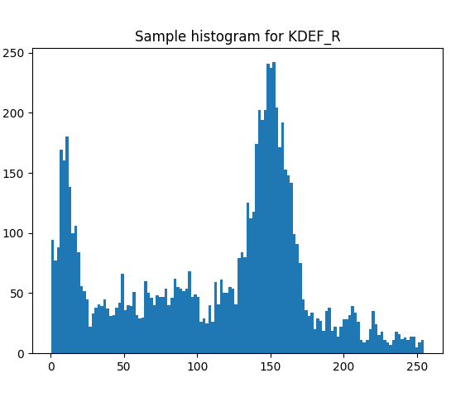
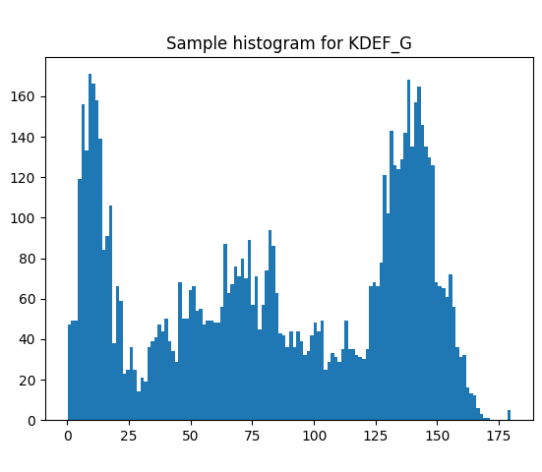
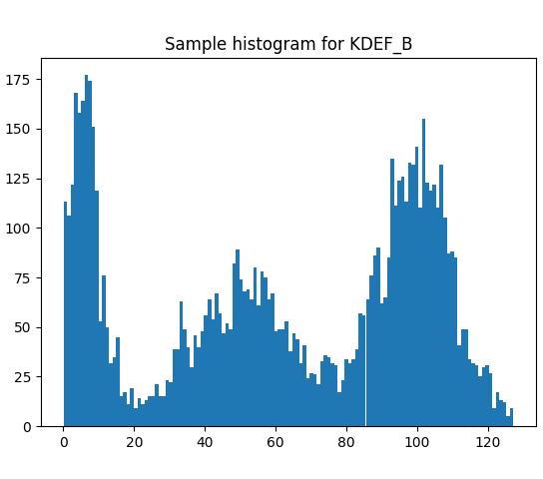
Histograms for input MoG - KDEF

Slide 5
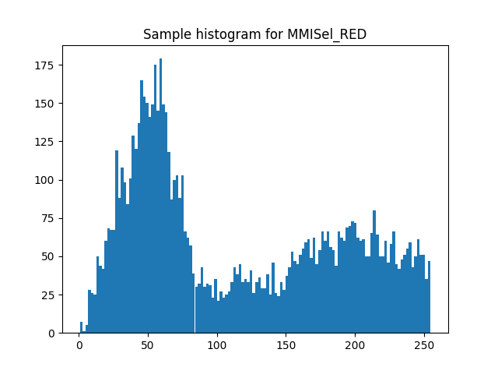
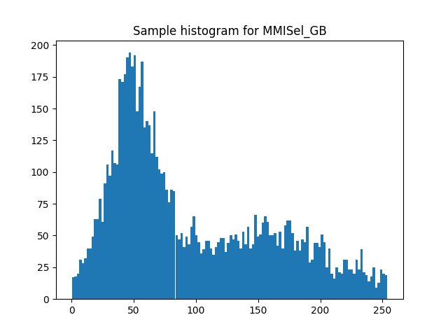
Histograms for input MoG – MMI Selected

Slide 6
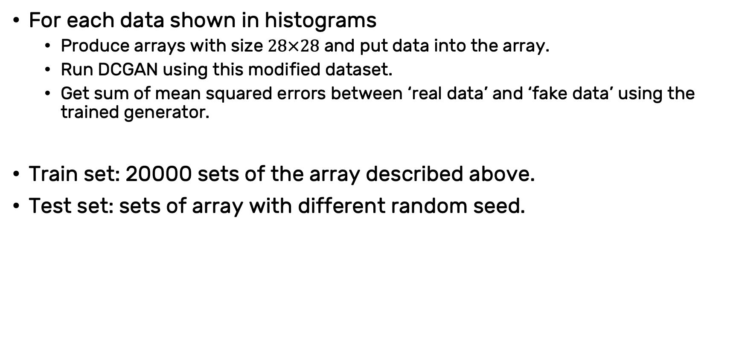
Test plans
For each data shown in histograms
Produce arrays with size $28×28$ and put data into the array.
Run DCGAN using this modified dataset.
Get sum of mean squared errors between ‘real data’ and ‘fake data’ using the trained generator.
Train set: 20000 sets of the array described above.
Test set: sets of array with different random seed.

Slide 7
Sample array created using MMISel_R
In form of image (.png)

Slide 8
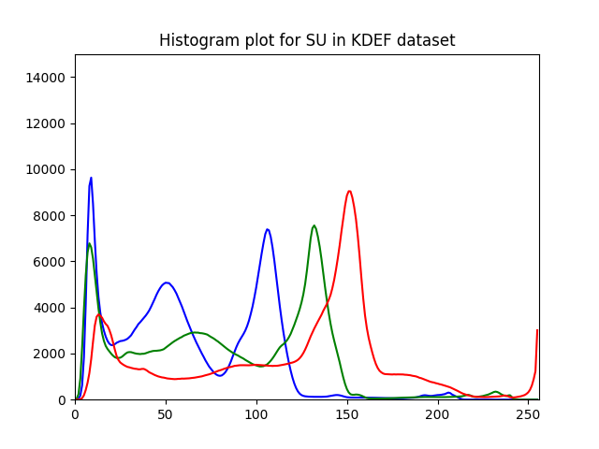
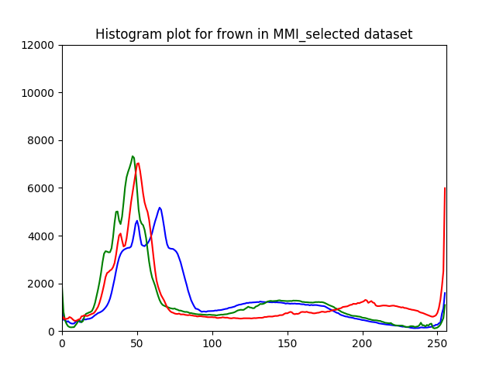
Reference - graphs for MoG

